Slide 1
Multilingual PII Detection System - Technical Documentation

Slide 2
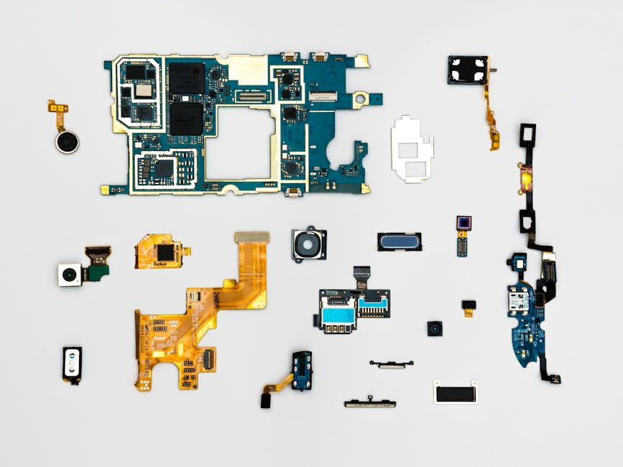
01
Introduction: Purpose & Motivation
02
Core Components Overview
Presentation Overview
03
Specialized Recognizers
04
Processing Pipeline & Validation
05
Performance & Conclusion

Slide 3
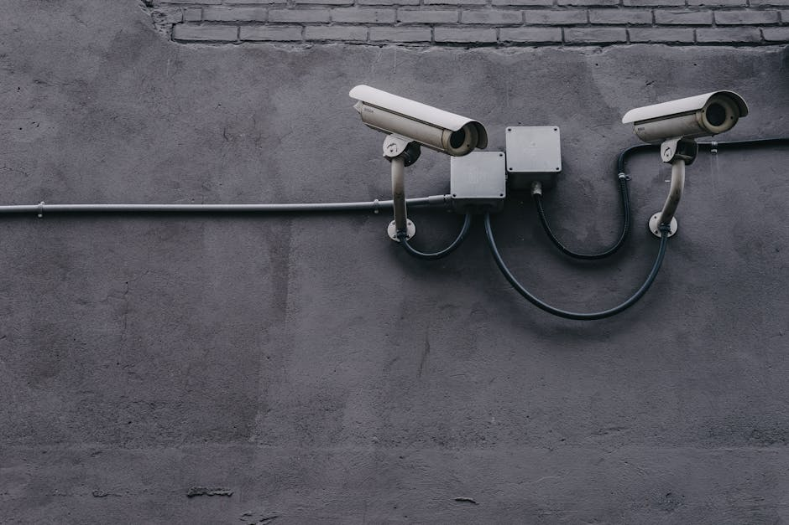
Introduction: Purpose and Motivation
Purpose
Detect and anonymize Personally Identifiable Information (PII) across multilingual content in English, French, and Arabic.
Motivation
Ensure privacy protection, meet regulatory requirements (GDPR, CCPA), and securely handle sensitive data.
Applications
Ideal for compliance audits, legal document processing, and corporate privacy solutions.

Slide 4

Core Components Overview
Detection Engines
- Microsoft Presidio Analyzer with custom Recognizers
- Regex-based detection for emails, phones, financials, addresses
- spaCy NER models for English and French
- Hugging Face Transformers pipeline for Arabic NER
Framework Integrations
Built on top of Python 3, Presidio, spaCy, Hugging Face, and Regex engines.
Multilingual Capabilities
Support for language-specific nuances in English, French, and Arabic.

Slide 5
Specialized Custom Recognizers
Financial and Phone Recognizers
- FinancialPIIRecognizer for IBANs, BICs, VAT numbers, Credit Cards.
- International and French Phone Recognizers for regional compliance.
Language-Specific Recognizers
- ArabicNameRecognizer and ArabicAddressRecognizer.
- FrenchNameRecognizer for French-specific personal names.
Advanced Detection
- CustomEmailRecognizer with advanced regex patterns.
- CryptocurrencyRecognizer for Bitcoin, Ethereum, Binance addresses.

Slide 6
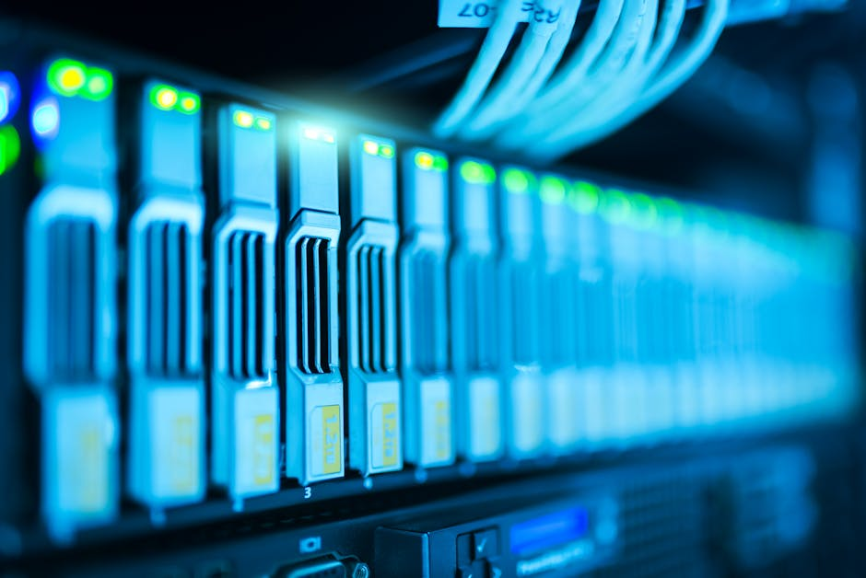
Validation Layer
Financial Validators
Validation of IBANs, BICs, Credit Cards, and VAT numbers using Luhn algorithm and Regex patterns.
False Positive Reduction
Avoid incorrect matches by strict pattern validation and scoring adjustments.
High Precision
Only verified and pattern-confirmed entities are passed to anonymization phase.

Slide 7
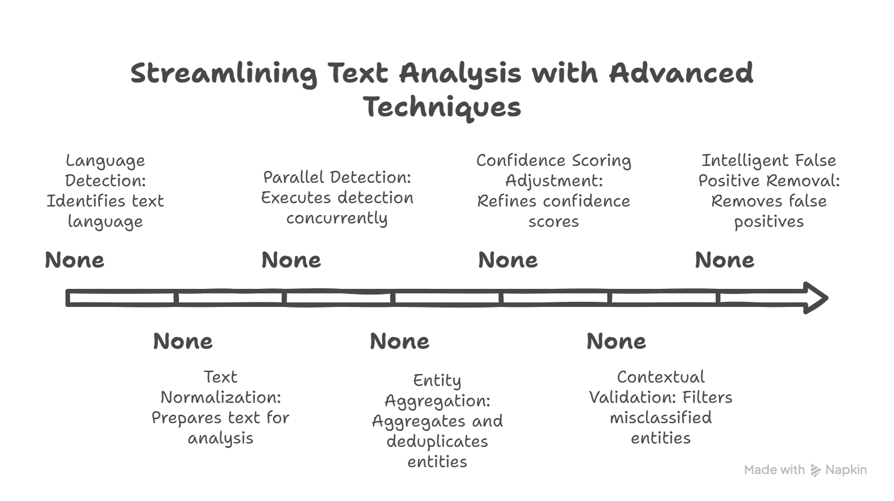
Processing Pipeline Flow

Slide 8

Anonymization Strategy
Redaction Approaches
Entities are masked by type: [EMAIL], [PHONE_NUMBER], [CREDIT_CARD], maintaining document structure.
Partial Masking
Sensitive numbers like IBANs and Credit Cards are partially masked to retain format clarity.
Configurable Strategies
Masking styles can be adapted based on organizational policies or compliance requirements.

Slide 9

Outputs Overview
Anonymized Output
Fully redacted text preserving format, layout, and readability.
Detected Entities Metadata
Detailed entity list with Type, Text, Start-End Positions, Confidence Scores, and Recognizer used.
Detection Statistics
Summary of detection counts per entity type, optional evaluation metrics (Precision, Recall, F1).

Slide 10
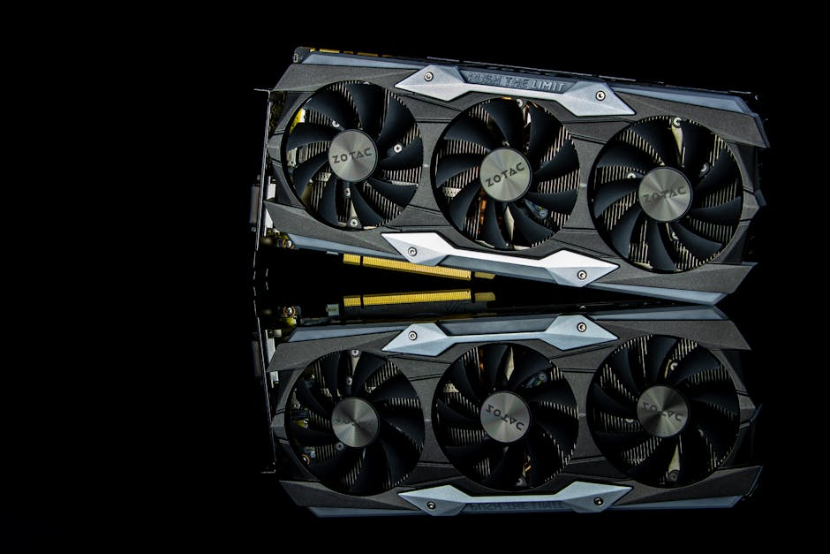
Performance and Scalability
Batch Processing
ThreadPoolExecutor used for concurrent document handling, speeding up large batch processing.
GPU Acceleration
CUDA-enabled GPU acceleration for Hugging Face models boosts Transformer-based entity extraction.
Memory Optimization
Text segmentation, smart batching, and efficient memory use enable processing of large documents.

Slide 11
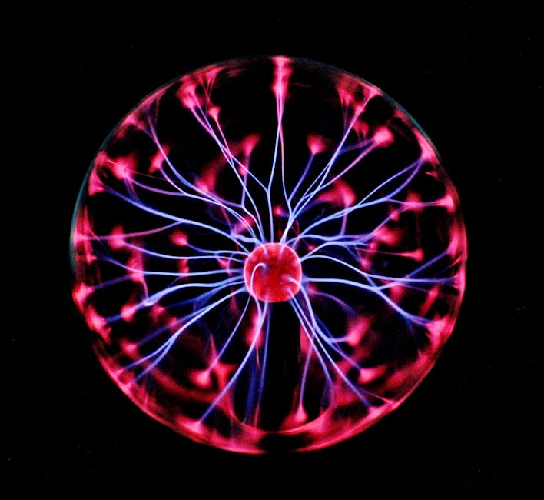
Technologies Used
Core Frameworks
- Python 3, Microsoft Presidio, Hugging Face Transformers, spaCy NER, Regex.
Language Identification & Validation
- langdetect for language detection, stdnum for financial ID validation.
Deployment Ready
- Designed for integration into production systems, scalable across cloud or on-premise deployments.

Slide 12
System Highlights
What makes this system production-ready?
Conclusion
- High multilingual detection accuracy.
- Specialized recognizers and validators reduce false positives.
- Scalable batch processing with memory optimization.
- Easily extensible for new languages and domains.

